Slide 1
Sustentacion / feedback
P.D: Después de mi sustentación, logre analizar el porqué mi algoritmo resuelve el problema dado con los datos dados como ejemplo, pero no el problema dado durante la sustentación.
Si bien el algoritmo está generado para encontrar la mayor cantidad de basura (lo que yo asumí como el objetivo principal), no está planeado para que esta se distribuya en la mayor cantidad de cuartos posibles. Lamento mi error en comprensión de lectura.

Slide 2
CHALLENGE: DYNAMIC PROGRAMMING
Sofia ZAMORA, 2022

Slide 3
Constrains
I always clean the rooms in the same order.
Rooms should be checked in the order of input.
Once I clean a room, the next room I going to clean must have the same or less amount of garbage than the previous one.
I can not go back to clean a room that i already ignored.
We can skip as many rooms as we want

Slide 4
WHAT WE KNOW
Total amount of dirt.
Access status to each room from every rooms.
Room check “path” order.
Dirt amount of each room.
Test Input/Output.
Goal: Clean the maximum amount of dirt possible.

Slide 5
Know test input/output
6
Elevator, 57
Hall, 889
Pingpong, 546
Cafeteria, 867
Terrace, 587
Terrace offices, 34
n = 4
4
Hall, 889
Cafeteria, 867
Terrace, 587
Terrace office, 34
n = 4 ; Sum = 2377

Slide 6
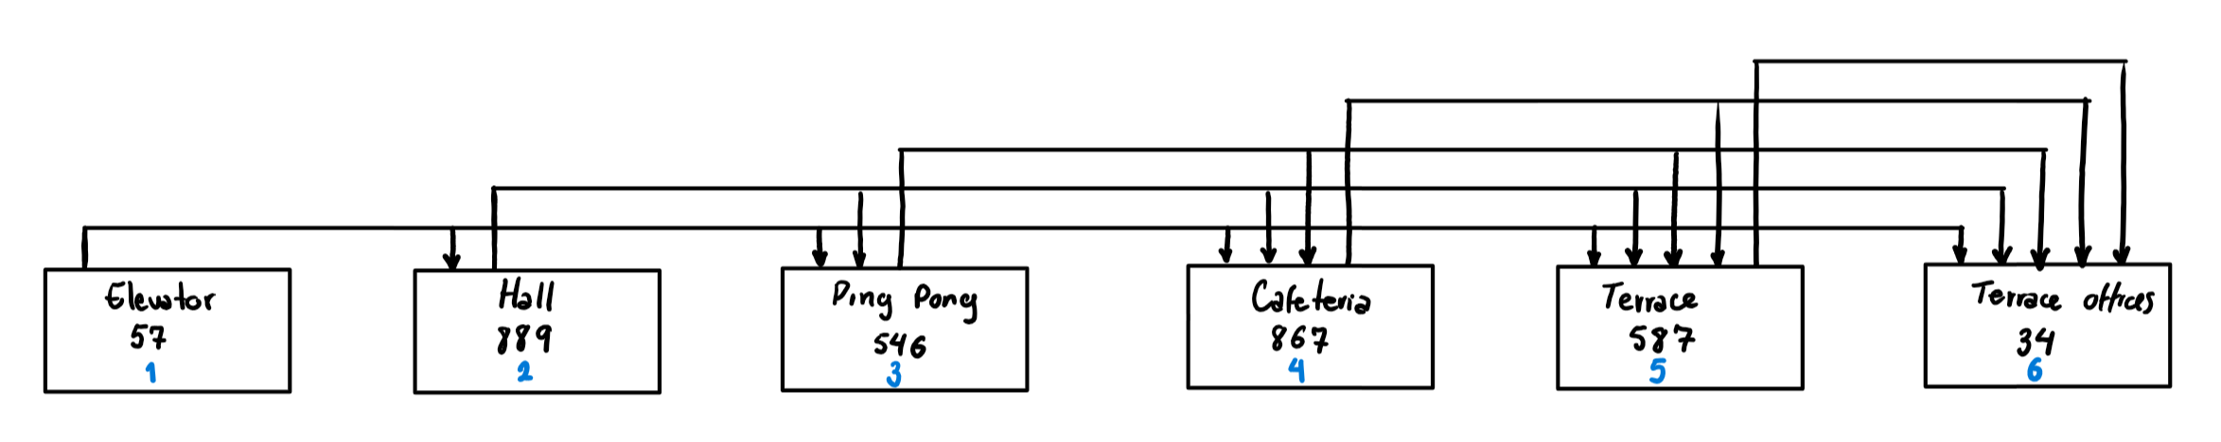
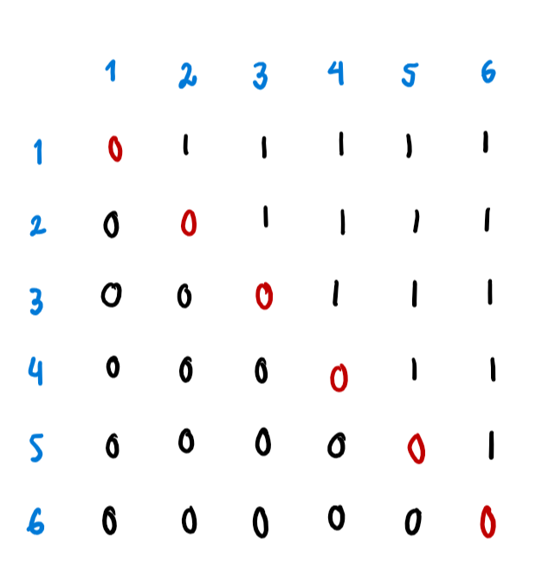
analysis
The order of access for n rooms it can always be represented by upper triangular matrix.

Slide 7
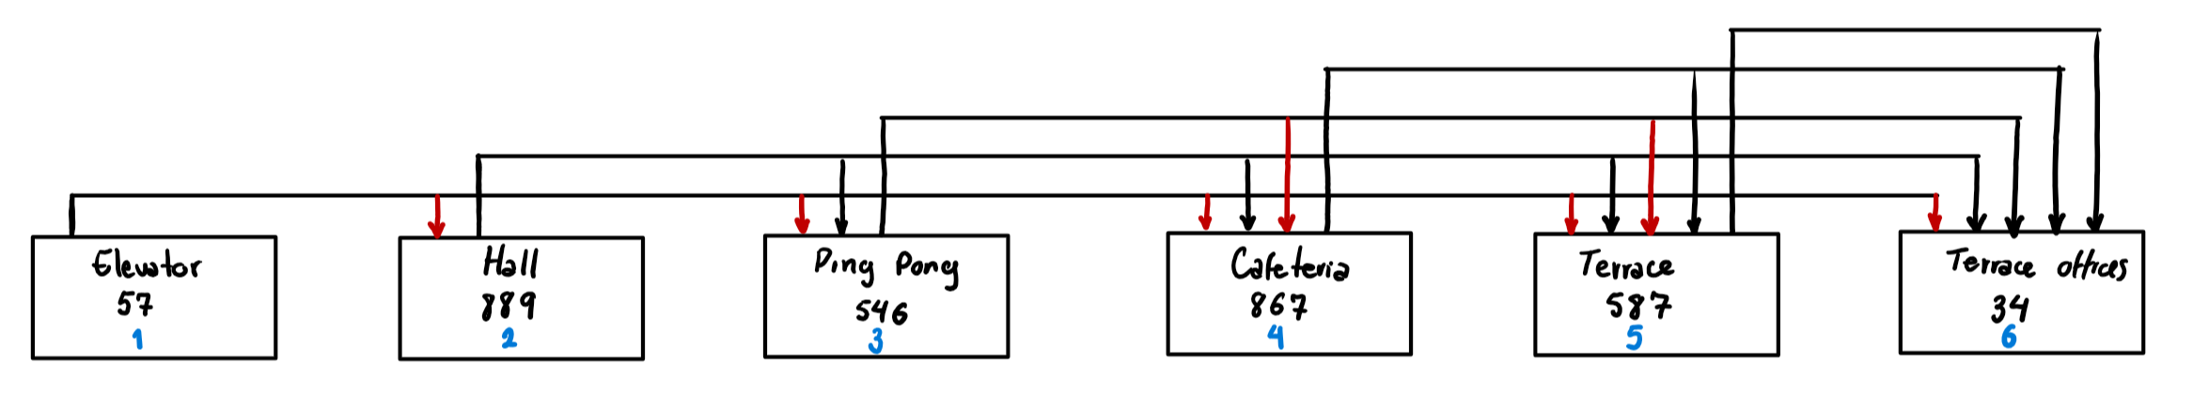
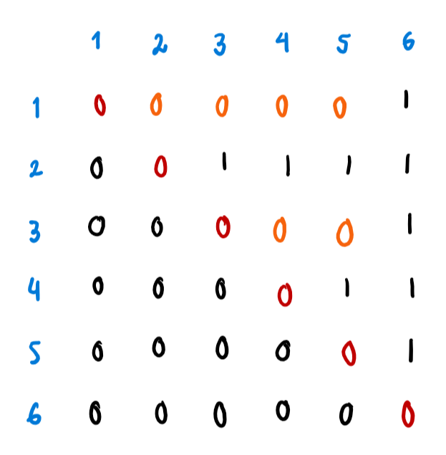
analysis
In the other half of the matrix we can establish access following the constraints of the problem.

Slide 8
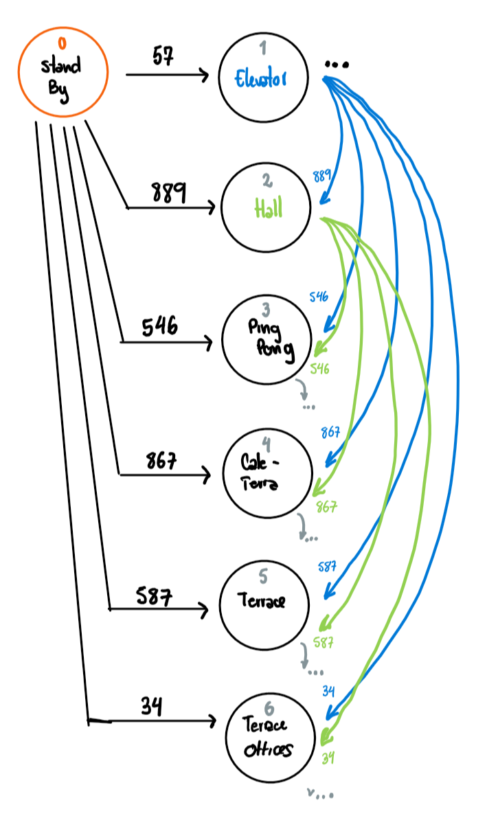
analysis
We can represent the rooms as a directed acyclic graph, with an initial node that can connects to every room and represents an initial stand by position of the vacuum.
G(V, E) ; V = nRooms

Slide 9
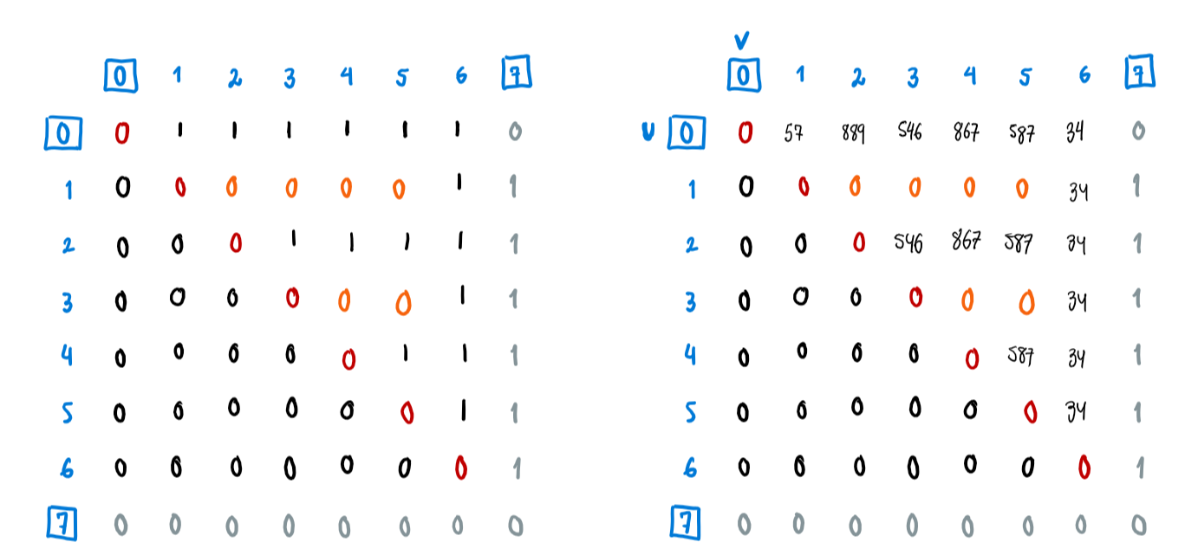
analysis
Adjacency Matrix with Weights
Adjacency Matrix

Slide 10
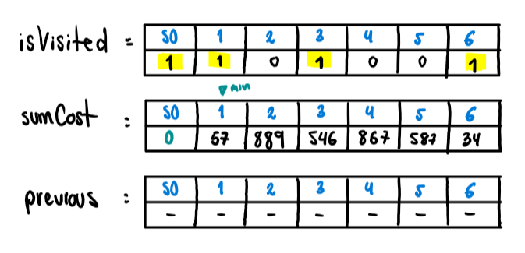
analysis
We can use the same principles as path finding algorithms for graphs, and stablish the goal of finding the longest path (more cost possible). In this case using Dijkstra’s Algorithm.
Select start node.
Search biggest cost.
Check summatory of cost and update if necessary.
Update previous node if necessary.

Slide 11
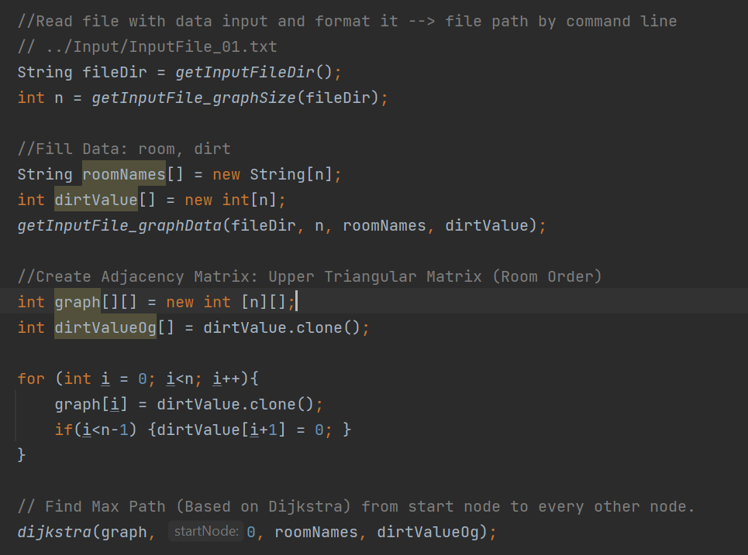
algorithm

Slide 12
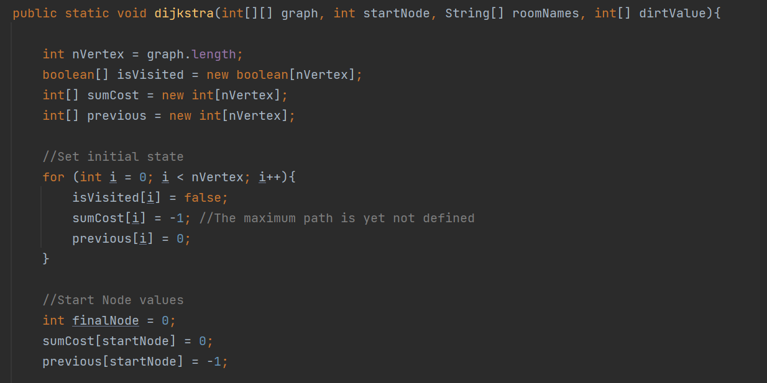
algorithm

Slide 13
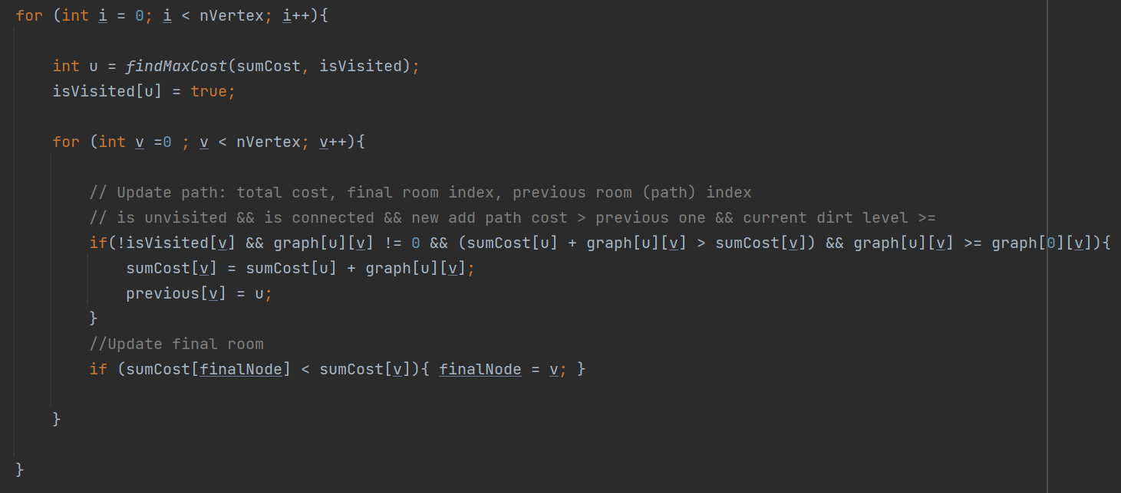
algorithm

Slide 14
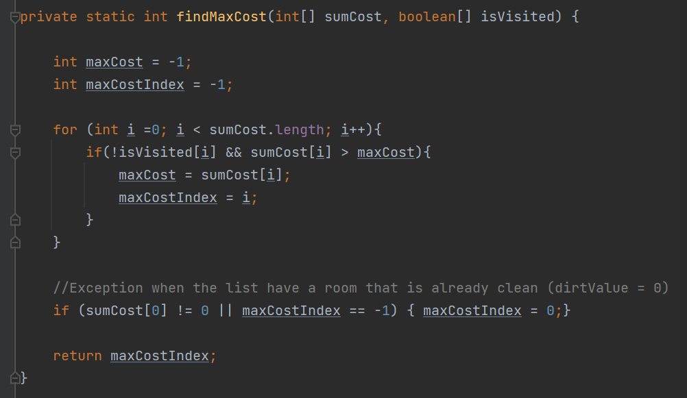
algorithm

Slide 15
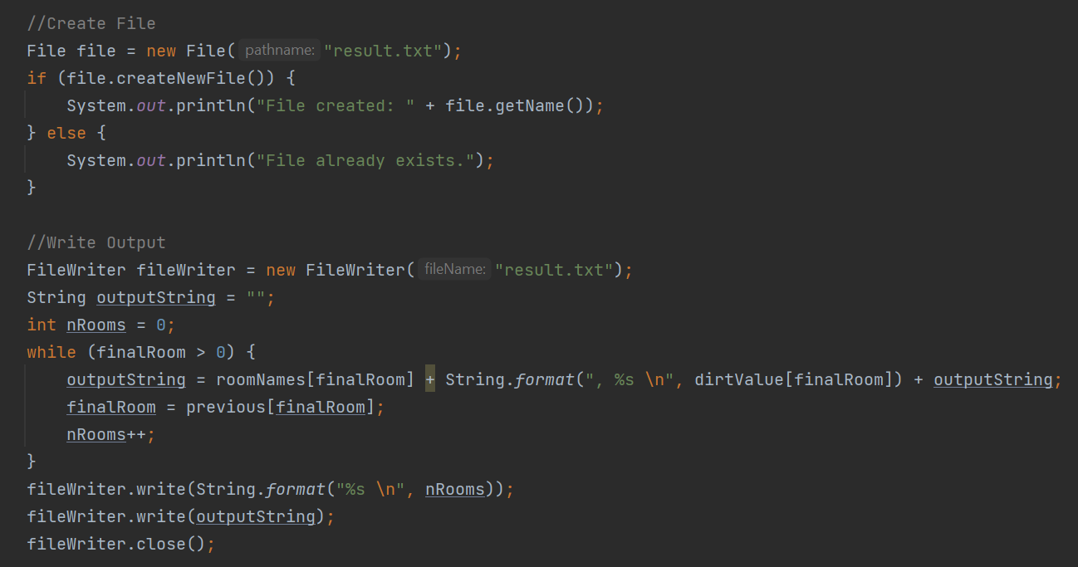
algorithm

Slide 16
Test cases
Know test input/output.
Manual Test
Decision Tree
Extreme Cases / Border Cases
Maximum cost node on the last room.
The sum of the first n - 1 rooms equals n-th node cost.
Ascending cost list and reverse ascending list
Big quantity of inputs
Cost of nodes = 0 (Room without dirt / All rooms are clean)

Slide 17
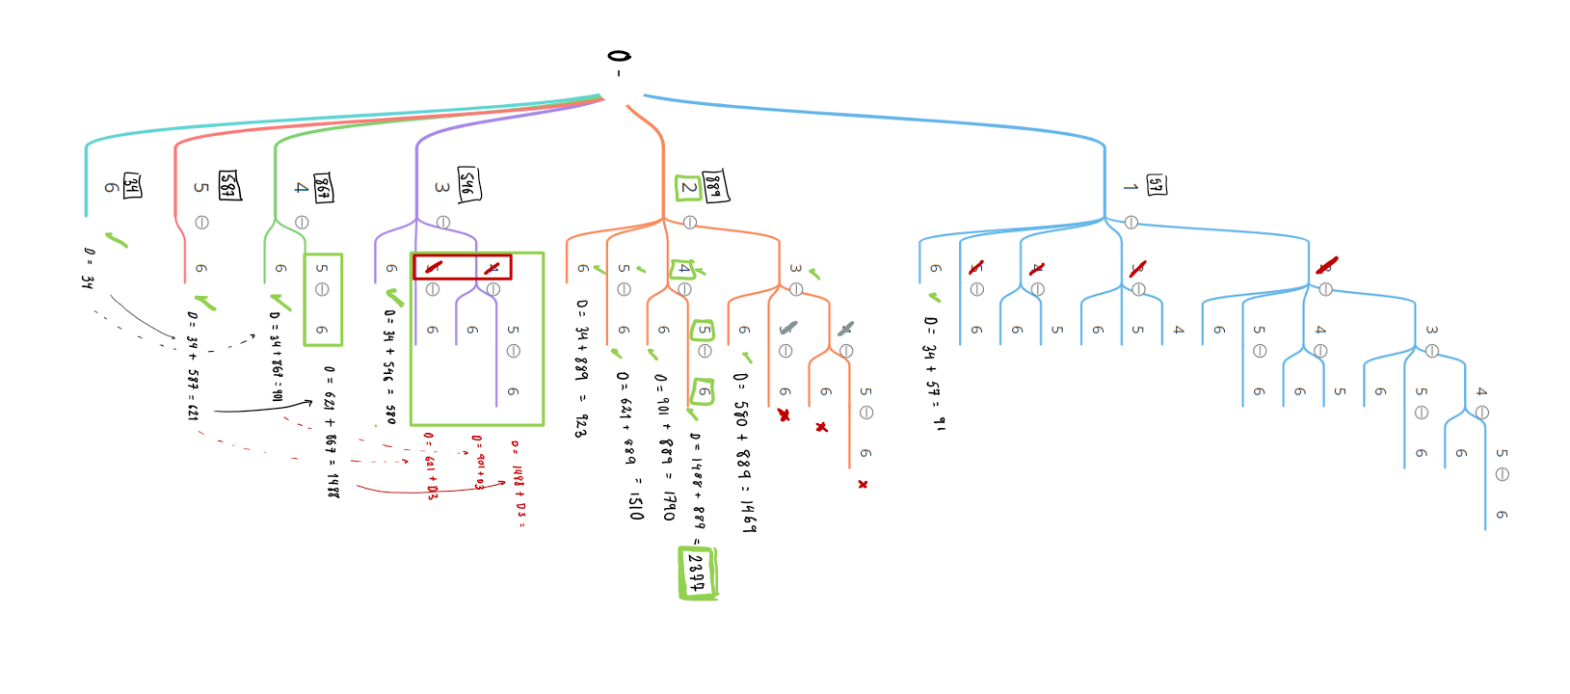
Test cases

Slide 18
Algorithm complexity
Space Complexity.
O(1)
We don’t use memory stack or linked list, just arrays of size n.
Time Complexity.
O(|E| log|V|) aproximadamente

Slide 19
ANGIE SOFIA ZAMORA T.
Developer intern

